Slide 1

S.P.M
WORK BREAKDOWN STRUCTURE.

Slide 2
CONTENTS…..
WBS.
PERT chart
Gantt chart.
PERT vs. Gantt.

Slide 3

Work VS Effort
Work. (Noun)
The task to be done or completed. The finished form of tasks.
Not quantifiable. But expressible as Scope or WBS.
Effort (Verb)
The attempt or the labor behind the completion of a task (or work).
Quantifiable as man-hours.

Slide 4
1. WBS: Work Breakdown Structure.
Psychologists say:
Our brains can normally comprehend around 7-9 items simultaneously.
A project with thousands or even dozens of tasks goes way over our
ability to grasp all at once.
The solution is to divide and conquer.
Solution – WBS
WBS is a hierarchical decomposition of the project into phases, deliverables and work packages.
Preparing and understanding a WBS for your project is a big step
towards managing and mastering its inherent complexity.

Slide 5
1.1 WBS History.
The WBS was initially developed by the U.S. defense establishment, and it is described in Military Standard (MIL-STD) 881B (25 Mar 93) as follows:
It is a deliverable oriented decomposition of a project into smaller components. It defines and groups a project's discrete work elements in a way that helps organize and define the total work scope of the project.
It displays and defines the product(s) to be developed and/or produced and relates the elements of work to be accomplished to each other and to the end product(s)."

Slide 6
WBS - Keywords.
Work to be done. Work elements.
Horizontal decomposition.
Divide and conquer. Work packages.

Slide 7
1.2 WBS: What, when and why.
A hierarchical outline (map) that identifies the products and work elements involved in a project.
Defines the relationship of the final deliverable (the project) to its sub-deliverables, and in turn, their relationships to work packages.

Slide 8
1.3 WBS: How does it help the PM?
Helps defining activities and tasks.
Helps in planning, scheduling, and budget preparation.
Helps assigning responsibilities.
Facilitates evaluation of cost, time, and performance.
Help decide whether COTS are needed or sub-contracting.
Helps in the development of the organization breakdown structure (OBS), which assigns project responsibilities to organizational units and individuals.
Defines communication channels and assists in coordinating the various project elements.

Slide 9
1.4 WBS Types/styles.
Tree/hierarchical WBS.
Hierarchical with coding.
Descriptive WBS (military style coding).
Phase Project/SDLC Phase

Slide 10
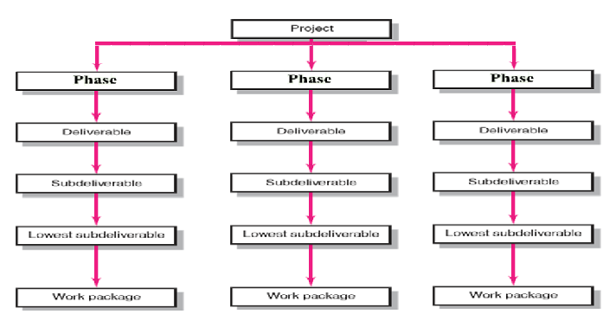
1.5 WBS Contents.

Slide 11
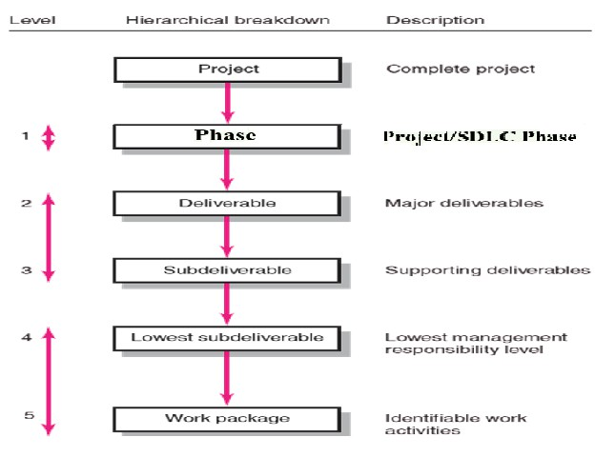
1.5 WBS Contents.

Slide 12
1.6 WBS: Work packages.
A WP work package is the lowest level of the WBS.
– It is output-oriented in that it:
Defines work (what).
This is the level where the PM has to monitor continuously. Identifies time to complete a WP (how long?).
Recommended: 8/80 rule. [8:Min, 80:Max]
Identifies a time-phased budget to complete a WP (what cost?). Identifies resources needed to complete a WP (how many?).
Identifies a single person/team responsible for units of work (who?).
Identifies monitoring points (milestones) for measuring success.
Activities that lead to work packages are identified in the activity chart

Slide 13
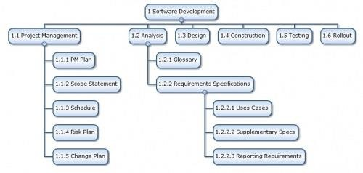
GENERAL FORM OF WBS

Slide 14
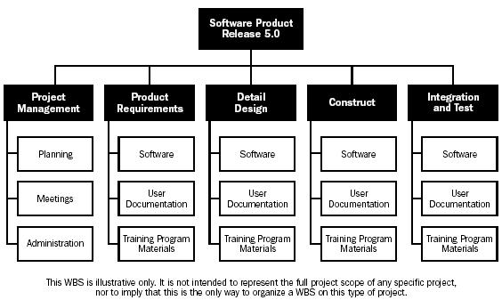
Example #1 – SIMPLE WBS.

Slide 15
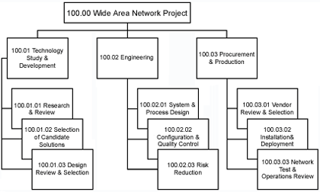
Example #2. – NETWORKING PROJECT WBS

Slide 16
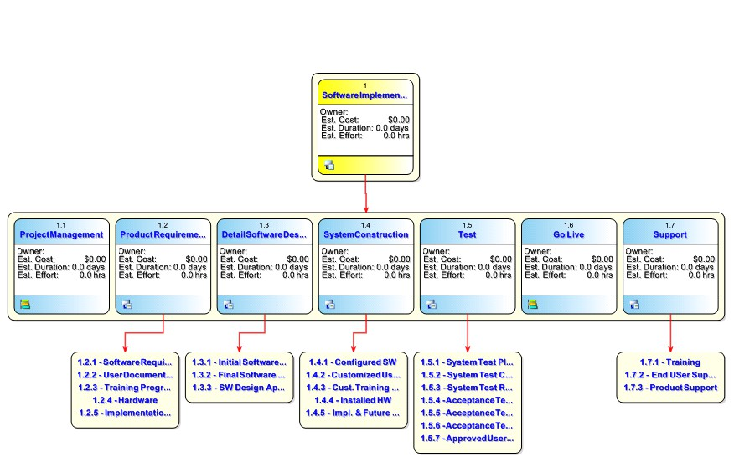
WBS Example #3.

Slide 17
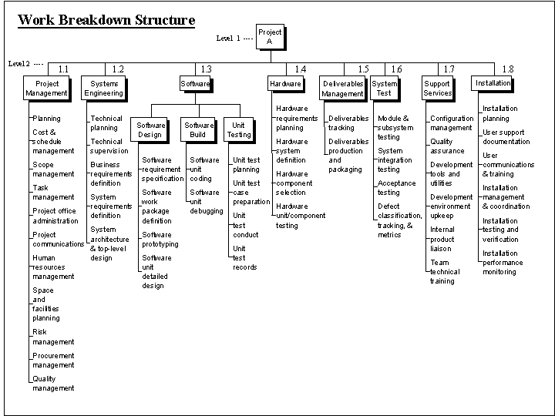
WBS Example #4.

Slide 18
TODAY’s ACTIVITY.
Describe the software project assigned to you on a single page.
Identify the major software deliverables necessary for this project.
Identify the sub-deliverables that make each of those major deliverables.
Try to ascertain the amount of time required to produce each sub deliverable and consequently the major sub-deliverables.
Try to ascertain the number of people needed to do these jobs.
Draw/write the WBS for this project

Slide 19
1.7 WBS – How To Prepare.
Identify final project products necessary for achieving project success.
The WBS should assist the project manager in developing a clear vision of the end product. You need to answer the following question:
  What must be delivered to achieve project success?
You may need to review the project scope documents for guidance.
Identify the major deliverables necessary for project success.
  These are (periodic) items that by themselves do not satisfy the project need but combined make up a successful project
Examples:
a design completion, status reports, or acceptance test completion report, etc.

Slide 20
1.7 WBS – How To Prepare? (cont’d).
Incorporate additional levels of detail until management requirements for managing and controlling the project are met.
  Remember that each project is different, thus each WBS will be different.
WBS’s from previous projects can be used as templates, but remember that the management philosophy and the level of details may be different from project to project
  Understand your controlling and reporting requirements. Projects have different requirements; make sure you take these into consideration when developing low level details
4. Review and refine the WBS until the client(s) agree with the level of project planning and reporting.
– Remember that no matter how detailed a WBS is, there are chances of change expected.

Slide 21
1.8 WBS vs. Organizational Chart.
These two items should not be mixed up.
WBS defines a project and groups its elements for better managing a project.
Organizational chart describes the organization or project team that accomplishes a project.

Slide 22
Project Scheduling.
The process of determining when project activities will take place depending on defined durations and precedent activities.
Schedule constraints specify when an activity should start or end based on duration, predecessors, external predecessor relationships, resource availability, or target dates.

Slide 23
Project Scheduling And Control.
Two major tools are used for the purpose of project scheduling and control:
PERT & CPM.
Using Network Analysis.
Gantt Charts.
Using Bar chart method.

Slide 24

2. Project Networks: PERT & CPM.
Projects and their activities can be represented by using network analysis techniques.
Two techniques are mostly used.
PERT – Program Evaluation and Review Technique.
First came known in 1958.
Was developed to evaluate the US Navy (Polaris) submarine projects.
This project was lagging behind schedules due to complexities in the activities involved.
PERT charts are network models.
CPM – Critical Path Method.
Used to find out the critical activities of a project. Introduced in 1957 by DuPont. Independent of PERT.
Later both PERT and CPM were merged into each other as one technique.
Load the following file.
SPM4a_CPM_AND_PERT.ppt
2. PERT.

Slide 25


